Slide 1
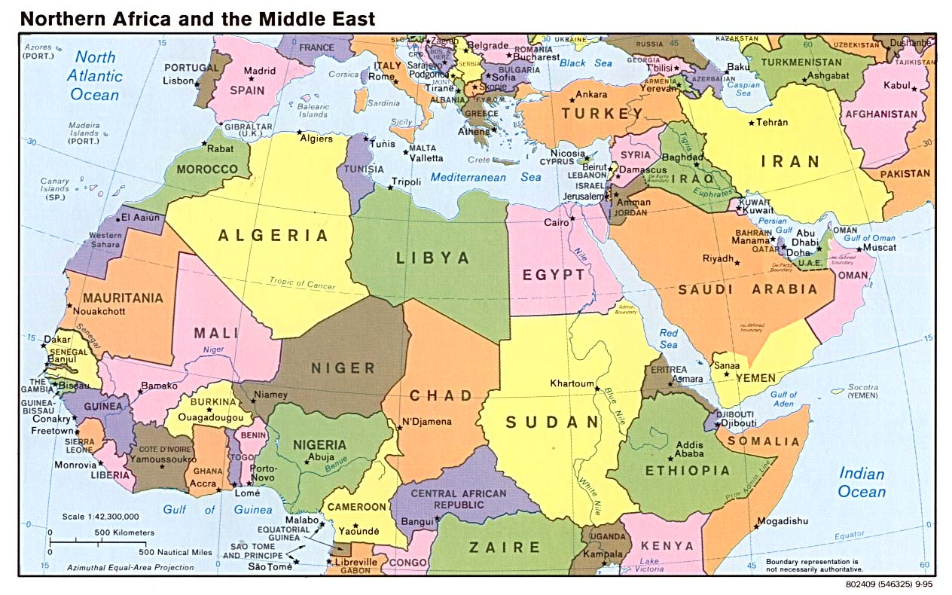
History of the Middle East

Slide 2
Defining the “Middle East”
Based on historical, cultural, linguistic, and religious connections, including the empires of Greece, Rome, Arab & Ottoman Turkey and contemporary events
We will use a definition that includes North Africa, the traditional “Middle East,” and Afghanistan

Slide 3
Size and Population
Country | Size (1000 sq miles) | Population (millions)
Morocco | 173 | 32
Algeria | 919 | 35
Tunisia | 63 | 10
Libya | 639 | 7
Egypt | 387 | 83
Sudan | 967 | 43
Eritria | 45 | 5
Somalia | 246 | 9
Saudi Arabia | 829 | 29
Yemen | 203 | 24
Oman | 119 | 3
Israel | 8 | 7
State of Palestine |  | 4
Lebanon | 4 | 4

Slide 4
Size and Population
Country | Size (1000 sq miles) | Population (millions)
Syria | 71 | 22
Turkey | 302 | 75
Jordan | 45 | 6
Iraq | 169 | 31
Iran | 636 | 74
Kuwait | 7 | 3
Arab Emirates | 32 | 5
Quatar | 4 | 1
Bahrain | .3 | 1
Afghanistan | 251 | 28
Total | 7773.3 | 541
USA | 3794 | 307

Slide 5
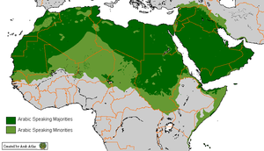
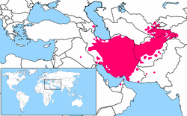
Languages
Arabic 280 million
native speakers,
250 million non-native
Farsi 80-134 million
Turkish 70 million
Kurdish 26 million
Hebrew 7 million
Armenian 7 million
Berber 10 million

Slide 6
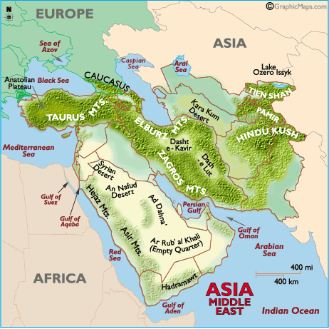
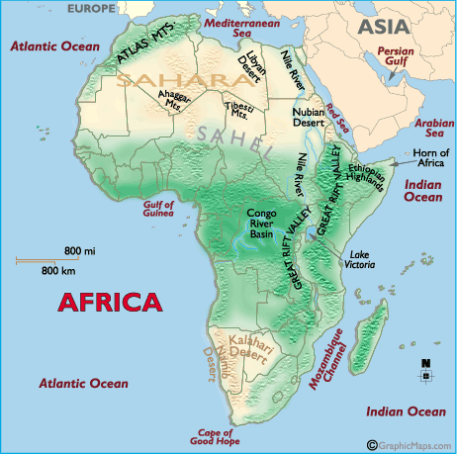
Diversity of Land Forms

Slide 7
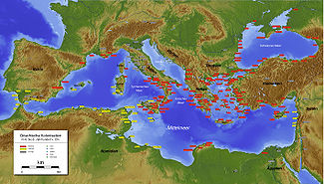
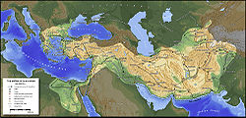
Ancient Empires
Greek Cities and Colonies (500 BC)
Alexander the Great
(323 BCE)

Slide 8
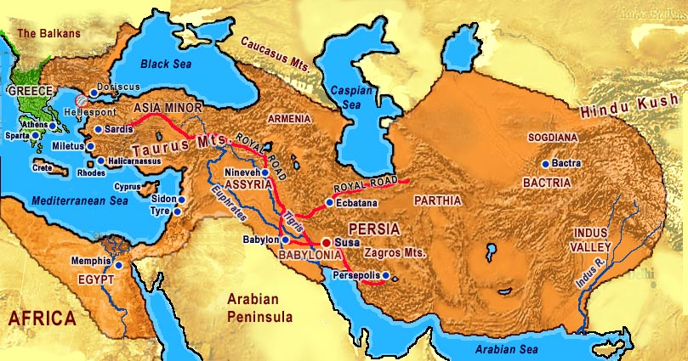
Persian Empire (500 BC)

Slide 9
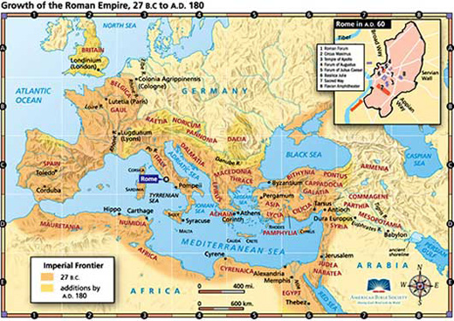
Roman Empire (180 CE)

Slide 10
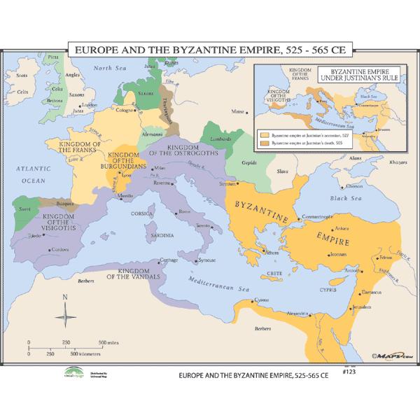
Byzantine Empire (550 CE)

Slide 11
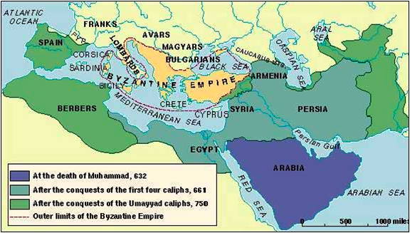
Arab Empire

Slide 12
Who Were the Arabs?
Code of virtue of desert nomadism: “bravery in battle, patience in misfortune, persistence in revenge (only justice possible when there was no government), protection of the weak, defiance of the strong, hospitality to the visitor (even total strangers), generosity to the poor, loyalty to the tribe, fidelity to promises.”
Highly democratic, assembly of chiefs – unity created by negotiation, clans independent

Slide 13
Arab Empire (632- ~1500)
Advent of saddle and use of camels
Islam (Muhammed 570-632 CE)
Muslim rule generally meant religious freedom and lower taxes
Non-Muslims could not bear arms, but were subject to their own laws (tolerance)

Slide 14
Arabic Cultural Flowering
Muslim culture assimilates Greek, Roman, Persian, and Hindu learning
Common language for theology, philosophy, science, and humanities
Seclusion and veiling of women not originally a Muslim practice, probably from Byzantium – during Muhammad’s day many women had significant freedom and public roles

Slide 15
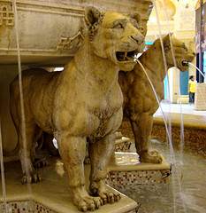
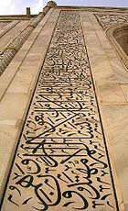
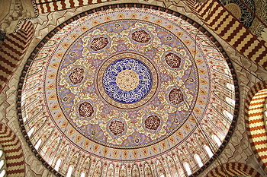
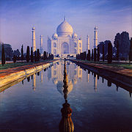
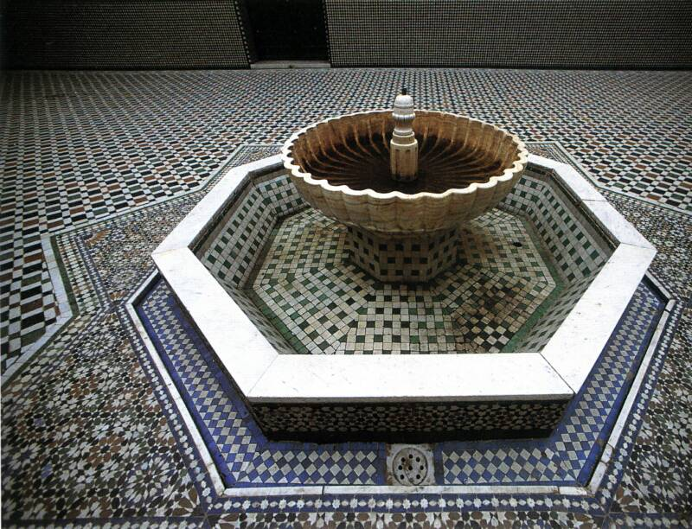
Islamic Architecture

Slide 16
Who is Arabic?
An Arab is a person who identifies as such on ethnic, linguistic or cultural grounds. Not a religious category – there are Christian and Jewish Arabs. Not a racial category, there are white, black and brown Arabs.
There are many famous Arab Americans, eg. John Sununu, Spenser Abraham, Ralph Nader, Frank Zappa, Salma Hayek, Diane Rehm, Christa McAuliffe, etc.

Slide 17
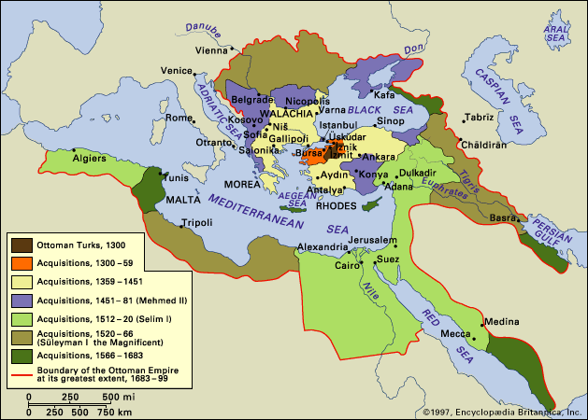
Ottoman Empire 1300 - 1922

Slide 18
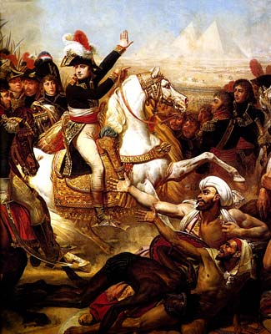
Napoleon Invades Egypt, 1798
Orientalism: Study of
the orient, according
to Edward Said
continues stereotypes
that reinforce the
“logic” of European
domination

Slide 19
Continued European Domination
1830 French conquer Algeria
1838 Unequal trading conventions favor Europe
1839 Britain takes Aden in Yemen
1881 French army occupies Tunisia
1882 Britain takes over Egypt, controls Suez Canal
1890-1910 Europeans build railroads, develop profit
1899 England controls the Sudan
1901 British “concessions” in Iran
1904 Spanish and French partition Morocco
1908 Founding of Anglo-Persian Oil Co. (Now BP – British Petroleum)
1911 Italy invades Libya

Slide 20
World War I
Ottoman Empire aligns with Germany, and is defeated
British and French foment Arab revolts against Ottomans (“Lawrence of Arabia”) and make promises to Arab leaders
Balfour Declaration (1917) support Jewish national home in Palestine.
Enormous toll: millions died from violence, starvation, and disease

Slide 21
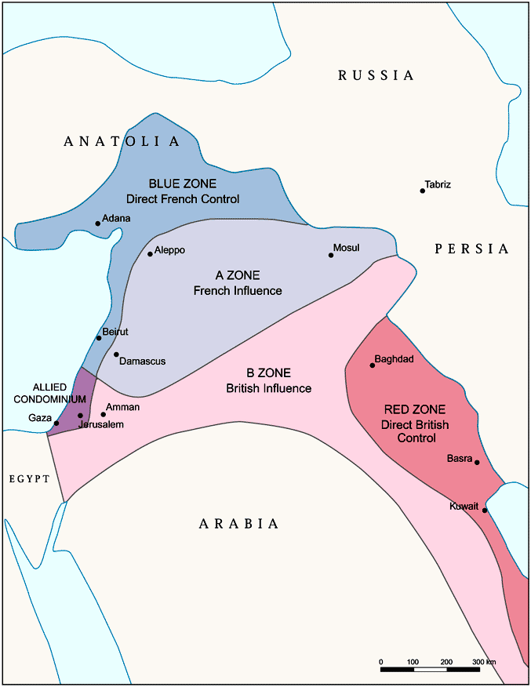
British and French “Mandates”
Secret agreement
divides Middle East
between Britain, France,
and Russia
United Nations approves
“mandates”
British and French install
leaders & governments

Slide 22
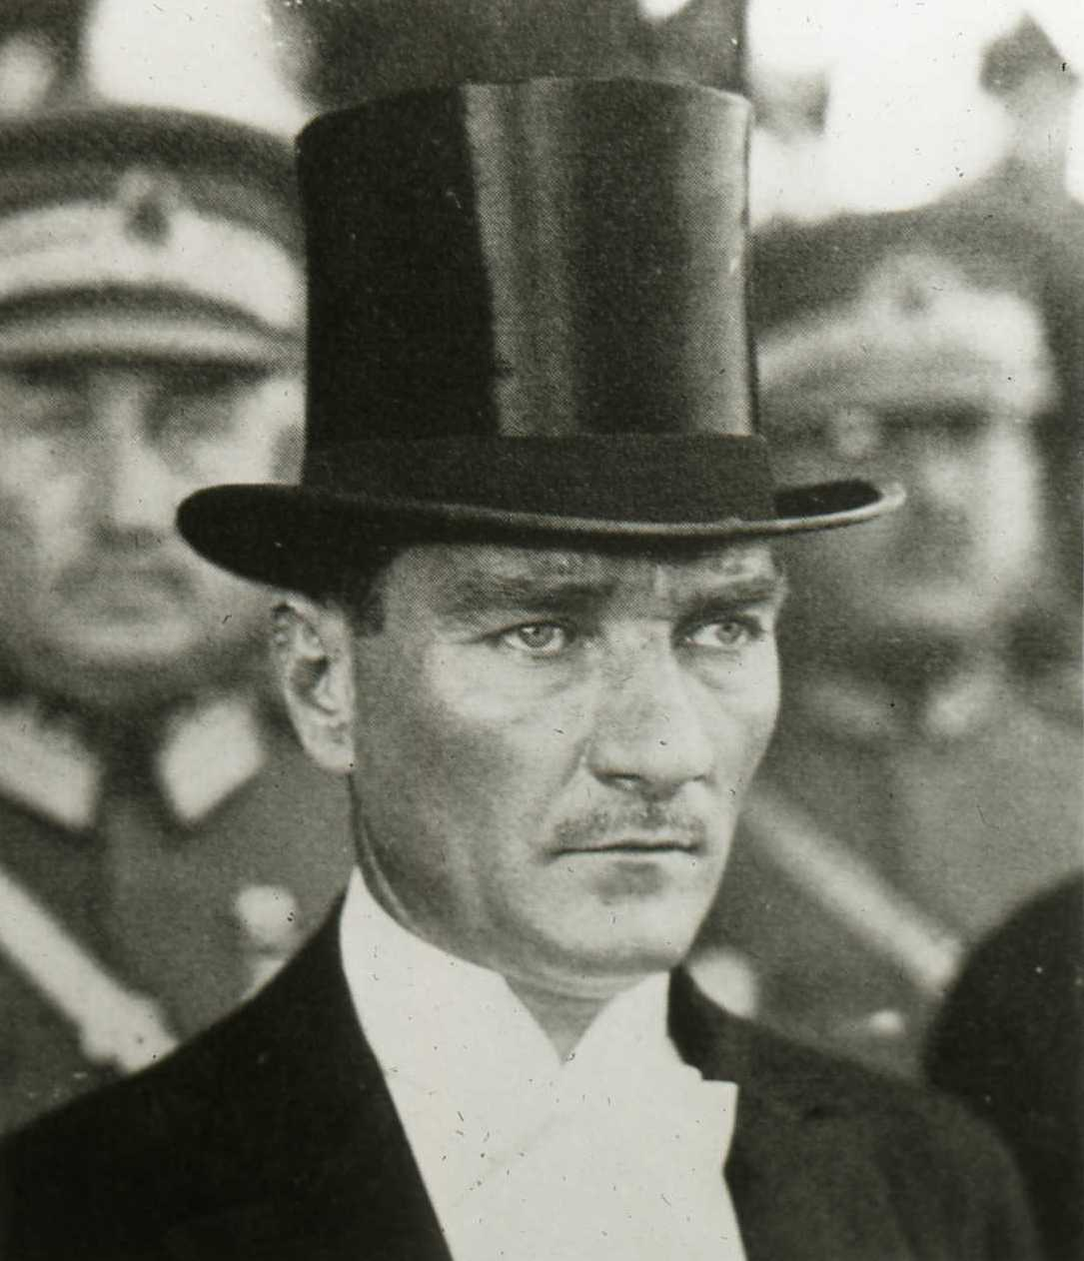
Turkish Revolt (1920-23)
Ataturk leads revolt
against British, French,
and Italian division of
Turkey, establishes
independent nation,
European oriented and
secular.

Slide 23
American Intervention I
1928 Red Line Oil Agreement with Britain to share Middle East Oil. Standard Oil and Mobil get shares of Iraq Petroleum Company
1944, the Anglo-American Petroleum Agreement divides Middle Eastern oil between the United States and Britain. Roosevelt says: Persian oil …is yours. We share the oil of Iraq and Kuwait. As for Saudi Arabian oil, it’s ours. (Between 1948 and 1960, Western capital earns $12.8 billion in profits from the production, refining and sale of Middle Eastern oil, on investments totaling $1.3 billion.)
1949 CIA back military coup in Syria, overthrows elected government
1953 CIA organizes coup in Iran, overthrows elected government putting Shaw in power
1956 CIA coup in Syria aborted
1957 Marines landed in Lebanon to prepare invasion of Jordan
1958 US Navy and Marines to Lebanon, threat of nuclear attack if Iraq invades Kuwait, invasion of Iraq planned with Turkey
1957-8 plots to overthrow Nasser, not successful
1960 US tries to overthrow government of Iraq
1963 US supports coup led by Ba’ath Party in Iraq, Saddam Hussein (on CIA payroll) comes to power
1973-5 US supports Kurdish rebels in Iraq, then abandons them
1978-79 US supports Shaw and tries to organize a coup to keep him in power
1979: Carter designates the Persian Gulf a vital U.S. interest and declares the U.S. will go to war to ensure the flow of oil.
1979: U.S. begins arming and organizing Islamic fundamentalist "Mujahedeen" in Afghanistan, Brzezinski writes, "This aid was going to induce a Soviet military intervention," drawing the Soviets into an Afghan quagmire. more than $3 billion in arms. Americans taken hostage in Iran.

Slide 24
Founding of Israel
Jewish immigration to Palestine, supported by Britain, increases after Nazi holocaust
1898 98% of Palestine is Arab
1922 88%
1931 81%
1947 66%
1948 Israel declared, Palestinian refugees, Arab forces defeated

Slide 25
America and Israel
1947: U.S. supports UN resolution partitioning Palestine, giving the Zionist authorities control of 54% of the land. (Jewish settlers 1/3 of the population.)
1948: War breaks out between newly proclaimed state of Israel, and Egypt, Iraq, Jordan and Syria, who had moved troops into Palestine to oppose the partition of Palestine. Israeli attacks force some 800,000 Palestinians--two-thirds of the population--to flee into exile in Lebanon, Jordan, Syria, Gaza, and the West Bank. Israel seizes 77 percent of historic Palestine. The U.S. quickly recognizes Israel.
1966 US sells jet bombers to Israel
1967 War with American support and takes remaining 23% of historic Palestine (West Bank, Gaza, Jerusalem, Sinai Peninsula & Golan Heights
1970 America supports attacks on Palestinian refugee camps
1973 2.2 Billion to Israel
1982 Israel invades Lebanon with US support, Sabra massacre

Slide 26
American Intervention II
1979 Soviet Troops enter Afghanistan at invitation of Afghan government, American “secret war” begins, funding of Osama Bin Laden and others, by 1989 over 1 million casualties, 1/3 of population refugees
1980 Candidate Ronald Reagan makes secret deal with the Islamic Republic: will allow Israel to ship arms to Iran if Iran continues to hold the hostages during the presidential campaign
1980 Iraq invades Iran with US support, US supports both sides, 1.5 million dead
1983 US troops to Lebanon
1983 CIA involved in murder of general in Morocco
1985 CIA attempts to kill Shiite leader in Lebanon
1986 US bombs Libya
1987 US shoots down Iranian airplane, all 290 passengers killed
1990 Iraq invades Kuwait after American “green light”
1991 “Desert Storm” 200,000 Iraqis killed, allows Iraq to attack Kurds and Shites
1992 Marines land in Somalia
1992 Department of Defense official plan "In the Middle East and Southwest Asia, our overall objective is to remain the predominant outside power in the region and preserve U.S. and Western access to the region's oil.”
1993 US Missile Attack on Iraq
1995 Oil and Trade Sanctions against Iraq, UN says 4,500 children die per month, 280,000 sorties flown over Iraq in 10 years
1998 Congress funds “secret” attacks against government of Iraq, missile attacks in Afghanistan and Somalia, Iraq
2001 Invasion of Afghanistan
2003 Invasion and occupation of Iraq, by 2009 over 1.5 million dead
Information Clearing House

Slide 27
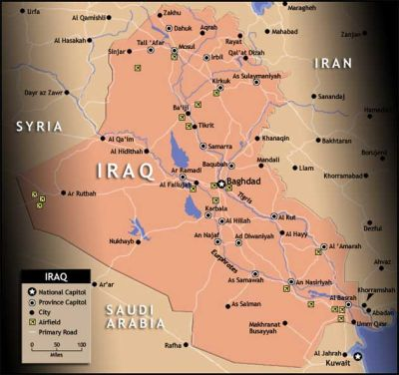
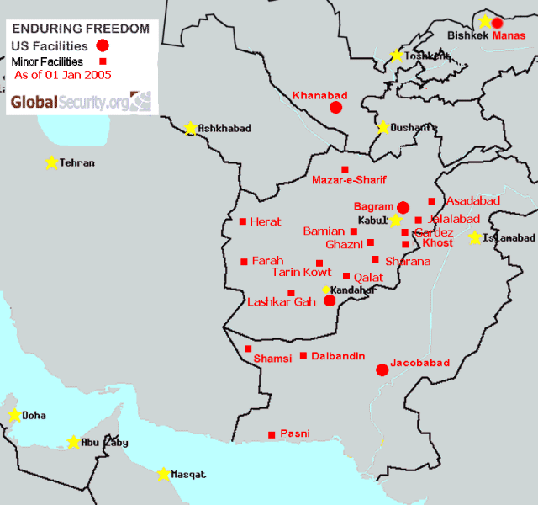
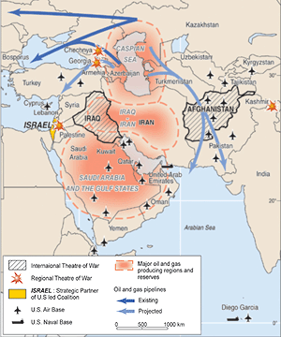
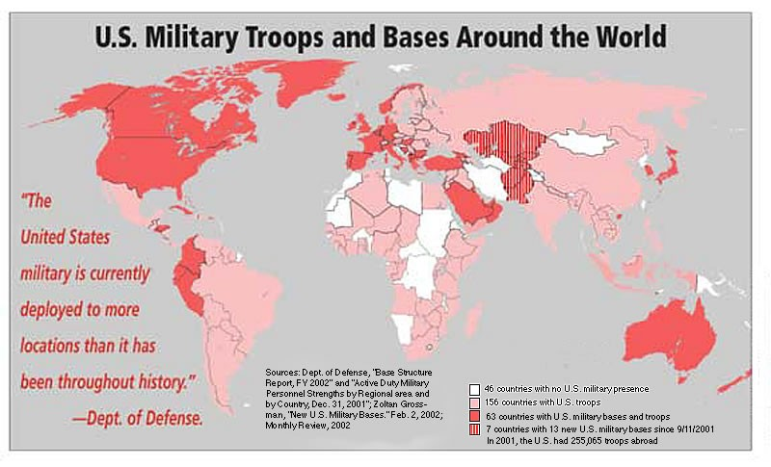
American Military Bases

Slide 28
Isms
Zionism
Nationalism
Pan Arabism
Arab Socialism
Ba’athism: the original secular Arab nationalist movement, to unify all Arab countries in one State and to combat Western colonial rule that dominated the Arab region at that time. In Arabic, Baʿath means "renaissance" or "resurrection"
Islamism: modern Muslims must return to their roots of their religion, and unite politically, elimination of Western military, economic, political, social, or cultural influences in the Muslim world

Slide 29
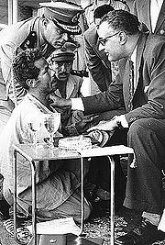
Gamal Abdel Nasser
1948 war with Israel
1952 Coup / Revolution
1956 Nationalize Suez
Pan-Arabism
1967 War

Slide 30
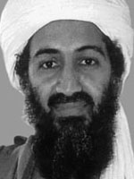
Afghanistan
American efforts to destabilize socialist regime and incite Russian invasion
Support of mujahidin
Taliban / Osama Bin Laden

Slide 31
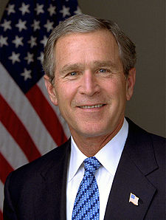
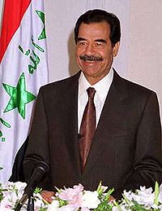
Iraq Wars

Slide 32
Why was Iraq invaded?
9/11? Weapons of Mass Destruction? Create democracy?
“Blood and Oil” (& “Blood and Oil: Middle East in WWI”)
Scott Ritter on Weapons of Mass Destruction and American Imperialism
(Scott Ritter on current Iran Controversy)

Slide 33
END

